Slide 1
Microsoft Azure Overview
Microsoft Research
Microsoft Azure for Research Training

Slide 2
Microsoft Azure Overview
Learning objectives – what you will learn:
Cloud computing basics
Patterns and terminology – IaaS, PaaS, SaaS
Microsoft Azure basics
Virtual machines
Web sites
Cloud services
Building blocks for applications – storage, messaging, identity, etc.
Cloud patterns for research scientists

Slide 3
Agenda
Cloud Computing Introduction
Microsoft Azure Overview
Microsoft Azure Websites
Microsoft Azure Virtual Machines (VMs)
Microsoft Azure Storage
Microsoft Azure Cloud Services
Notes:
Slide Objectives:
Introduce the topics that will be covered in this session
VALUE PROP
Speaking Points:
Notes:

Slide 4
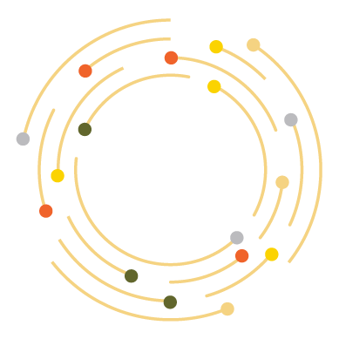

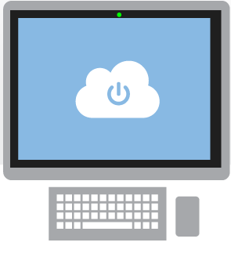
What is the cloud?
An approach to computing that’s about internet scale and connecting to a variety of devices and endpoints
Notes:
Speaking Points:
There are numerous terms and definitions floating around in the industry for “the cloud”, “cloud computing”, “cloud services”, etc.
Microsoft thinks of the cloud as simply an approach to computing that enables applications to be delivered at scale for a variety of workloads and client devices.
The cloud can help deliver IT as a standardized service…freeing you up to focus on your business

Slide 5
Cloud Computing Patterns
On and Off
Inactivity
Period
On & off workloads (e.g. batch job)
Over provisioned capacity is wasted
Time to market can be cumbersome
Compute
t
Growing Fast
Compute
Successful services needs to grow/scale
Keeping up w/ growth is big IT challenge
Cannot provision hardware fast enough
t
Unpredictable Bursting
Compute
Unexpected/unplanned peak in demand
Sudden spike impacts performance
Can’t over provision for extreme cases
t
Predictable Bursting
Compute
Services with micro seasonality trends
Peaks due to periodic increased demand
IT complexity and wasted capacity
t
Notes:
Slide Objectives:
Describe the various computing patterns that are good for Cloud Computing
Speaking Points:
There are numerous terms and definitions floating around in the industry for “the cloud”, “cloud computing”, “cloud services”, etc.
Microsoft thinks of the cloud as simply an approach to computing that enables applications to be delivered at scale for a variety of workloads and client devices.
The cloud can help deliver IT as a standardized service…freeing you up to focus on your business
Cover the workloads in the slide

Slide 6


Cloud Computing Variants
Packaged Software
Infrastructure
(as a Service)
Platform
(as a Service)
Software
(as a Service)
Applications
Applications
You manage
Applications
Applications
Data
You manage
Data
Data
Data
Runtime
Runtime
Runtime
Runtime
Managed by vendor
You manage
Middleware
Middleware
Middleware
Middleware
Managed by vendor
O/S
O/S
O/S
O/S
Virtualization
Virtualization
Managed by vendor
Virtualization
Virtualization
Servers
Servers
Servers
Servers
Storage
Storage
Storage
Storage
Networking
Networking
Networking
Networking
Notes:
Slide Objectives:
Explain the differences and relationship between IaaS, PaaS, and SaaS in more detail.
Speaking Points:
Here’s another way to look at the cloud services taxonomy and how this taxonomy maps to the components in an IT infrastructure.
Packaged Software
With packaged software a customer would be responsible for managing the entire stack – ranging from the network connectivity to the applications.
IaaS
With Infrastructure as a Service, the lower levels of the stack are managed by a vendor. Some of these components can be provided by traditional hosters – in fact most of them have moved to having a virtualized offering.
Very few actually provide an OS
The customer is still responsible for managing the OS through the Applications.
For the developer, an obvious benefit with IaaS is that it frees the developer from many concerns when provisioning physical or virtual machines.
This was one of the earliest and primary use cases for Amazon Web Services Elastic Cloud Compute (EC2).
Developers were able to readily provision virtual machines (AMIs) on EC2, develop and test solutions and, often, run the results ‘in production’.
The only requirement was a credit card to pay for the services.
PaaS
With Platform as a Service, everything from the network connectivity through the runtime is provided and managed by the platform vendor.
The Microsoft Azure best fits in this category today.
In fact because we don’t provide access to the underlying virtualization or operating system today, we’re often referred to as not providing IaaS.
PaaS offerings further reduce the developer burden by additionally supporting the platform runtime and related application services.
With PaaS, the developer can, almost immediately, begin creating the business logic for an application.
Potentially, the increases in productivity are considerable and, because the hardware and operational aspects of the cloud platform are also managed by the cloud platform provider, applications can quickly be taken from an idea to reality very quickly.
SaaS
Finally, with SaaS, a vendor provides the application and abstracts you from all of the underlying components.

Slide 7
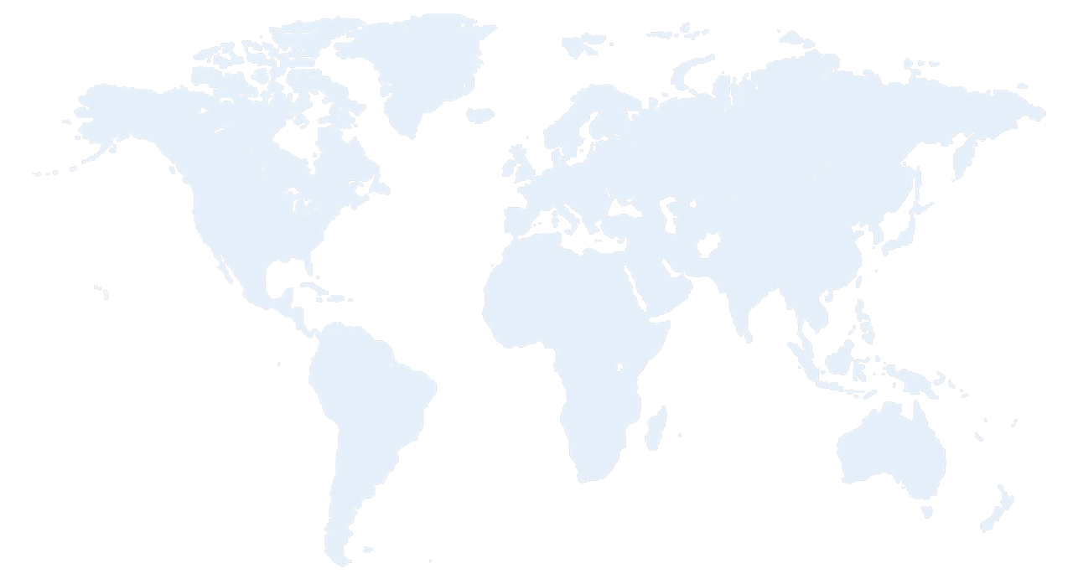


Azure Datacenter Regions
North America
Europe
Asia Pacific
N. Europe
Japan West Region
Central
N. Central
W. Europe
West US
China North
Japan East Region
East US
East US 2
S Central US
China South
E. Asia Region
S.E. Asia
Region
Brazil South
Regions
Australia
Notes:
Speaking Points:
Microsoft Azure itself is deployed around the world
With Microsoft Azure, we have a concept of regions, which is where you choose to place your code and run.
In each of the regions, we have a Microsoft datacenter.
These datacenters are massive facilities that host 14s or in some cases hundreds of thousands of servers
We have currently four regions in North America, two regions in Europe, and two in Asia
As you can see on this slide we also have a number of CDN edge points, which we can use to cache your content and deliver it even faster for customers. %
What you’re going to see in the next couple months and years is that we will rapidly expand our datacenter footprint around the world, so you will have more options for running your applications.
Once you build an application, you can choose where you want to run in the world and you can move your workloads from region to region.
You can also run your application in multiple regions simultaneously and just direct traffic and customers to whichever version of the app is closest to them.
That gives you a global footprint and a chance to reach a bigger customer base or audience in new markets
All Azure services are available in all the Azure regions at GA
AP & Cosmos are the exceptions and are in specific DCs

Slide 8
Australia
Austria
Belgium
Brazil
Canada
Chile
Colombia
Costa Rica
Cyprus
Czech Republic
Denmark
Finland
France
Germany
Greece
Hong Kong
Hungary
India
Ireland
Israel
Italy
Japan
Korea
Luxembourg
Malaysia
Mexico
Netherlands
New Zealand
Norway
Peru
Philippines
Poland
Portugal
Puerto Rico
Romania
Russia
Singapore
Spain
Sweden
Switzerland
Trinidad & Tobago
UK
United States
New Countries:
Algeria
89
countries and territories
Argentina
Belarus
Bulgaria
Croatia
Dominican Rep
Ecuador
Egypt
El Salvador
Estonia
Guatemala
Iceland
Indonesia
Jordan
Kazakhstan
Kenya
Kuwait
Latvia
Liechtenstein
Lithuania
Macedonia
Malta
Montenegro
Morocco
Azerbaijan
Nigeria
Oman
Pakistan
Panama
Paraguay
Qatar
Saudi Arabia
Serbia
Slovakia
Slovenia
South Africa
Sri Lanka
Taiwan
Thailand
Tunisia
Turkey
UAE
Ukraine
Uruguay
Venezuela
Bahrain
Notes:
Speaking Points:
Microsoft Azure is commercially available in over 89 countries and territories.
Anyone within these countries can sign up for a free trial or a paid subscription to use Microsoft Azure services
Of course you can build and deliver solutions to any of your customers worldwide.

Slide 9
>57%
Greater than
1,000,000
>250k
Fortune 500 using Azure
Active websites
SQL Databases in Azure
>20
>1
TRILLION storage objects
>300
MILLION
AD users
MILLION
Developers registered with Visual Studio Online
>2
MILLION requests/sec
>13
BILLION
authentication/wk

Slide 10
Pay only for what is used
There is no upfront cost
There is no need to buy any server licenses
If you use a SQL database, no need to buy a SQL Server license
For Virtual Machines and Web Sites, pay by the hour
Scale up and scale down your solutions – or even turn them on and off as necessary – cost is scaled appropriately, automatically
Evaluation period is no cost at all, of course – including this training

Slide 11
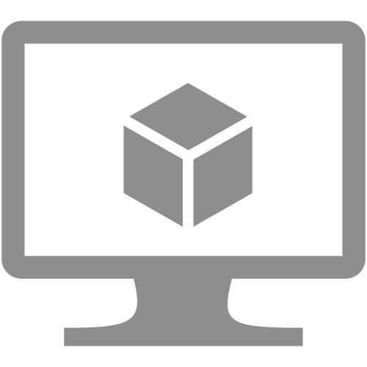


Virtual machines
Cloud services
Web sites

Slide 12
Microsoft Azure Portal
Demo

Slide 13
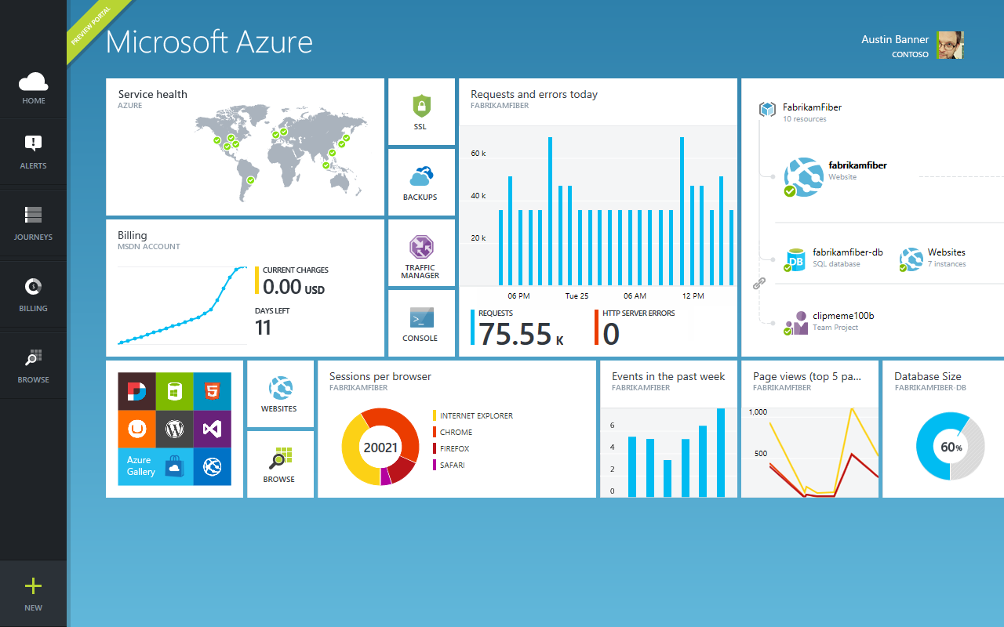

Slide 14
Virtual machines Windows Server & Linux
You can use remote desktop or SSH and run any workload
These virtual machines enable you to be admin on the box
They are durable, meaning if you reboot the VM, it is still there with all of your changes and data you stored to disk
With virtual private networking, you can deploy Virtual Machines in the cloud and group them together so they are part of their own private network
Notes:
Transition:
For the rest of this talk I’m going to give you a tour of Microsoft Azure, walk you through many of the features, and ground you in the capabilities it provides
The first set of features I want to walk through is Virtual Machines.
Speaking Points:
If you’re familiar with traditional hosting, this is probably the feature that feels most familiar and consistent with what other hosting providers provide.
The ability to stand up a virtual machine with either Windows or Linux that you can basically remote desktop in or SSH in and run any workload.
These virtual machines enable you to be admin on the box
They are durable, meaning if you reboot the VM, it is still there with all of your changes and data you stored to disk
This means you can run any type of workload
If you want to run SQL you can, if you want to install a no-SQL solution, you can do that to.
If you want to run SharePoint you can do that.
Provides ultimate flexibility to do what you want to do
Also enables you to do what we call virtual private networking
With virtual private networking, you can deploy Virtual Machines in the cloud and group them together so they are part of their own private network
You can also then connect it back to your corporate network (if you have one) and establish a VPN secure tunnel to link your machines running in your own corporate environment up to your virtual machines in the cloud – making them look like they’re all part of one connected network.
So lots of flexibility in the compute side as well as in the networking side.

Slide 15






VM with persistent storage
VM with persistent drive
Virtual machines have drives that are backed up in the Microsoft Azure storage
When you mount a drive on a VM it is triply replicated
If one goes bad, we automatically create a replica
From your VMs perspective you never know that an issue actually occurred
Microsoft Azure Storage

Slide 16



Continuous storage geo-replication
WEST
DC
EAST
DC
> 500 miles
Microsoft Azure Storage
Whenever you save something in the storage system, in the background we automatically replicate the data to another datacenter
This feature can be turned off if you don’t want this to happen
Notes:
Speaking Points:
The third aspect of Microsoft Azure Virtual Machines that is important to understand is ….
Another thing that is nice about the Microsoft Azure Storage solution is that we have support for Continuous storage geo-replication
What this means is that whenever you save something in the storage system, in the background we can automatically replicate the data to another datacenter
We guarantee that these data centers are several hundred miles (500) apart so that in the case of a natural disaster or a complete data center failure you can be ensured that a copy of your data exists somewhere else.
You don’t have to set anything up to enable it. It’s automatically enabled by default.
You can turn it off if there are policy reasons why you wouldn’t want it enabled.
The end result is that you can deliver more robust solutions with even greater integrity

Slide 17
Web sites
Build with .NET, Java, Node.js. PHP or Python
Deploy in seconds with TFS/Git/FTP/Mercurial/Dropbox
Start for free, scale up as your traffic grows
You don’t have to worry or think about VMs, servers, or infrastructure…
You can simply focus on building and deploying HTTP based applications
Allows you to use any tool and any operating system to build these sites including Windows, OS X, and Linux
Machine instances can be registered with a load balancer and scaled out as needed to additional VMs
Notes:
Speaking Points:
Transition
Virtual machines provide a very flexible compute model.
Another compute service available in Microsoft Azure is called Microsoft Azure Web Sites.
Definition:
Microsoft Azure Web Sites there is a managed service that you can use to run web sites and web APIs.
Enable you to quickly stand up web applications and web sites on the internet
Auto-managed environment
Just say that you want a web, here’s the DNS, copy the content, and we do the rest
You don’t have to worry or think about VMs, servers, or infrastructure.
You can simply focus on building and deploying HTTP based applications.
Enables you to build web sites using ASP.NET, Node.js, PHP, and now with an update a few weeks ago – Python
Allows you to use any tool and any operating system to build these sites including Windows, OS X, and Linux.
Enables a very fast deployment model. You can literally deploy in seconds.
You can easily deploy these sites using the tools and infrastructure you know.
We support several flexible deployment options including FTP, GIT, and Team Foundation Services
What is nice about this offering is that not only does it enable to very quickly get going, but it also allows you to start with a free offer in a shared environment.
Pricing starts at free.. Perpetually free and then you can scale up as you need more capability
You can then scale up these sites using reserved instances for higher performance and isolation and scale out these sites as your web site becomes successful and you have increased load.
Deployment with:
Cloud-hosted source control system: Visual Studio Online, Git, Mercurial, Dropbox
IDE: Visual Studio, WebMatrix
FTP
On-premise source control system: TFS, on premise Git or Mercurial repositories
Command Line tools and REST API: MSBuild, FTP scripts, PowerShell, .NET Management API, Cross-platform command line(xpat-cli), Web Deploy command line

Slide 18
Cloud services
Cloud Services is another model we support for building applications
Build highly scalable apps and services
You might have a combination of front ends, middle tiers, as well as virtual machines running as part of your solution
Automated application management
Notes:
Speaking Points:
We’ve talked about Virtual Machines and we’ve talked about Web Sites, now let’s talk about Cloud Services
Cloud Services is another model we support for building applications.
Cloud Services enable a broader set of workloads then Microsoft Azure Web Sites, while providing more automated management then Microsoft Azure Virtual Machines.
Enables you to build what we sometimes refer to as infinitely scalable applications. They can support 1 to hundreds or thousands of course
Support not only web based deployments, but also multi-tier architectures where you might have a combination of front ends, middle tiers, as well as virtual machines running as part of your solution.
Supports automated application management, so it is really easy to deploy, scale out, isolate, and recover from any type of hardware failure. As well as support for automated updates.

Slide 19
What is a Cloud Service?
A container of related service roles
Web Role
Worker Role
A design pattern and tool kit for multi-tier applications
Web Roles are web server instances
Worker Roles are the VM that manage computation and data
Notes:
Note: VM is separated out as IaaS offering.

Slide 20










Application building blocks
HDInsight
Database
Storage
Traffic
Caching
Messaging
Identity
Media
CDN
Networking
Notes:
Speaking Points:
In addition to the compute services for running your deploying and running your code, Microsoft Azure also provides a number of application building blocks.
These are managed services that we run that provide a lot of value so you can avoid standing up the infrastructure for common capabilities
You always can stand up VMs and put anything you want in it
But in a lot of cases you will find that we have built in services that we deliver or that are delivered by our partners
What’s cool is that you can use any of these services with a VM, with a Web Site, or with a Cloud Service – so you have flexibility in how you will consume them.

Slide 21
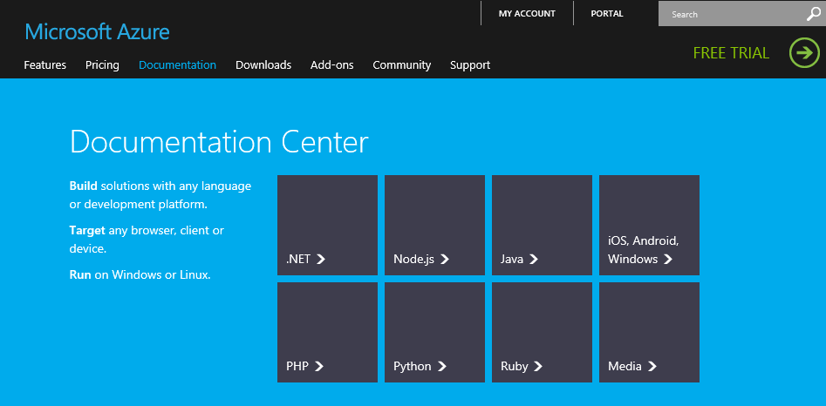
Multiple programming languages
.NET, Node.js, Java, PHP, Python, Ruby
For each option we provide libraries that you can consume that call into the REST APIs that we expose for the building block services
You can also call the REST APIs directly
Notes:
Speaking Points:
All of these services can also be used from multiple languages
We now have as part of our developer center on WindowsAzure.com support for multiple different languages including .NET, Node, Java, and PHP.
One of the new languages that we’re now enabling is Python with a complete SDK and dev center.
For each of these we provide libraries that you can consume that call into the REST APIs that we expose for the building block services.
You can also call the REST APIs directly

Slide 22
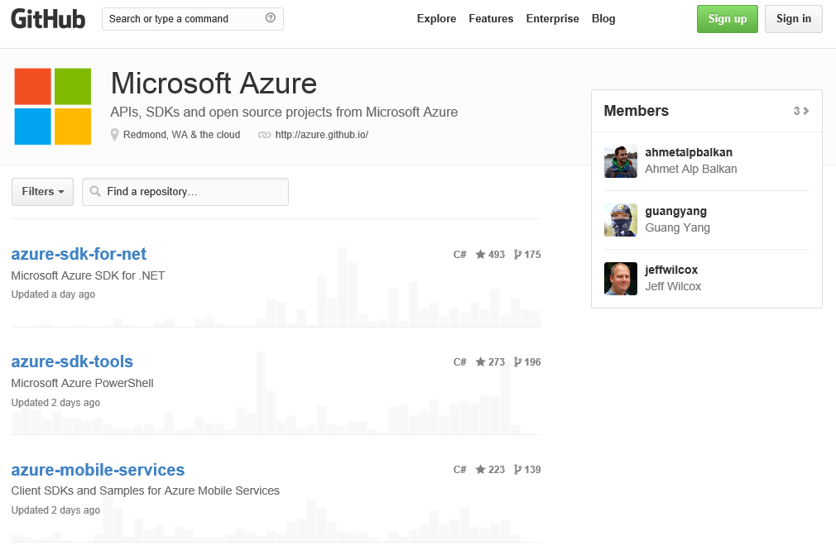
Open Source
→ http://github.com/azure
Notes:
Speaking Points:
All of the libraries are hosted on GitHub under an Apache 2 license
So you can both see the source and contribute back to the source

Slide 23
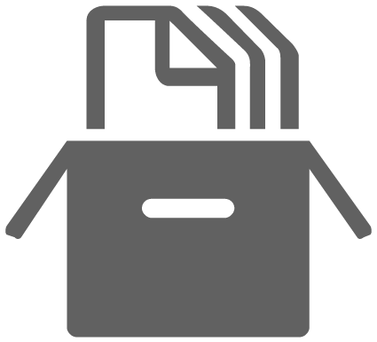
Blob storage
A highly available, scalable, and secure file system in the cloud
Store any type of data
Expose storage through HTTP URLs and make it public or you can make it private
Create a new storage account in a few minutes
Continuous geo-replication is enabled by default for storage accounts
Read-Access Geographically redundant storage (RA-GRS) is an eventually consistent copy of the data in the primary storage.
Notes:
Speaking Points:
We have a great storage system.
We talked about this earlier as part of virtual machines for mounting drives.
You can think of blob storage as a highly available, scalable, and secure file system in the cloud.
You can store any type of data you want in it.
You can optionally expose storage through some HTTP URLs and make it public or you can make it private.
Similar to databases, you can stand up a new storage account in a few minutes.
Continuous geo-replication is enabled by default for storage accounts.
Read-Access Geographically redundant storage: in addition to geographically redundant storage, we provide read-only access to the storage account in the secondary region that will have an eventually consistent copy of the data in the primary storage. Customers can use this service to access their data when the storage account in the primary region is unavailable

Slide 24

Service bus
Secure messaging and relay capabilities
Securely integrate cloud based solutions with on premise environments
Enable loosely coupled solutions
Cross platform libraries so you can use service bus from any OS
Notes:
Speaking Points:
We also have a bunch of new service bus capabilities
The Service Bus is a managed service that provides secure messaging and relay capabilities.
It’s great for integrating cloud based solutions with on-premise environments in a very secure way
and it enables a very loosely coupled architecture
With the new Microsoft Azure SDK and Tools for Visual Studio, you can now view information about the service bus directly from within Visual Studio.
We are also now introducing cross platform libraries so you can use service bus from any OS whether it’s a VM, web site, or Cloud Service and with any of the languages we support.

Slide 25


Microsoft Azure – Application Scenarios
Ideal for Applications Needing:
Scalability
Availability
Fault Tolerance
Common Application Uses:
Web Sites
Compute Intensive apps
Data Intensive apps
Device Applications
Notes:
VM: A Work environment in the Cloud
Manual workstation burst, R Matlab
VM as a Testing Environment
Blog Storage: Store and share your Data in the Cloud
Use persistent queue and table to scale embarrassingly parallel workload
Publish Reproducible Simulations in the Cloud

Slide 26
Cloud Patterns for Research Scientists
Microsoft Azure Execution Models
Which should I choose?
Virtual machines – most general solution, IaaS
Web sites – best for simple web hosting, specific PaaS
Cloud services – best for sophisticated web solutions, full PaaS
All three let you build scalable, reliable applications in the cloud. Which you use depends on what you’re trying to do.

Slide 27
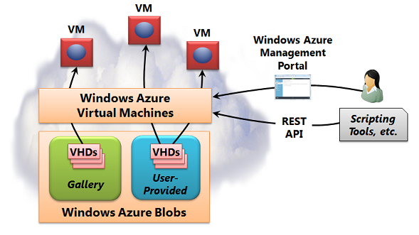
Cloud Patterns for Research Scientists
Microsoft Azure Virtual Machines – when to use:
IaaS – infrastructure as a service
If you need Linux persistent VMs
Extending your own infrastructure into the cloud
Disaster recovery
Notes:
Ref: https://www.windowsazure.com/en-us/manage/windows/fundamentals/compute/#Vmachine

Slide 28
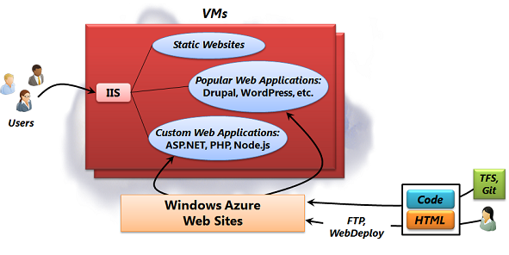
Cloud Patterns for Research Scientists
Microsoft Azure Web Sites – when to use:
Simple web sites
Easy and fast – site in seconds
Built on Microsoft Azure cloud services to create a PaaS optimized for web applications
Many web applications, frameworks and templates readily available as building blocks, e.g. Joomla, WordPress, Drupal, etc.
Notes:
Ref: https://www.windowsazure.com/en-us/manage/windows/fundamentals/compute/#WebSites

Slide 29
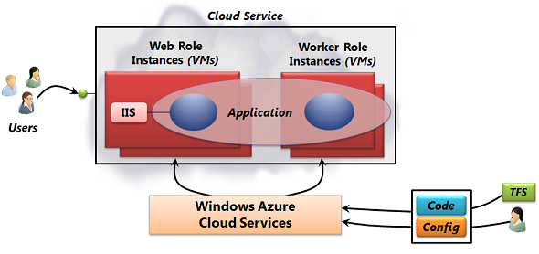
Cloud Patterns for Research Scientists
Microsoft Azure Cloud Services – when to use:
Full PaaS – platform as a service
VM web roles for web services
VM worker roles for processing
Application uses a combination of roles
Unlike Microsoft Azure web sites: admin access, separate staging and production, flexible connectivity, remote desktop access to VMs
Unlike Microsoft Azure VMs: OS updates handled for you, lower operations overhead
Notes:
Ref: https://www.windowsazure.com/en-us/manage/windows/fundamentals/compute/#CloudServices

Slide 30
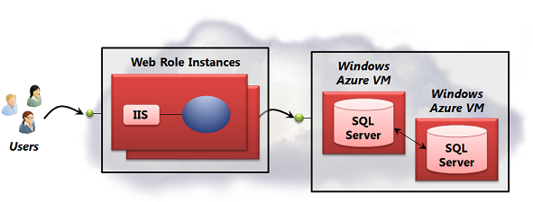
Cloud Patterns for Research Scientists
Some typical usage patterns in science:
VM as a work environment in the cloud
Manual workstation burst for R or MATLAB
VM as a testing environment
Blob storage to share your data in the cloud
Persistent queue and table to scale embarrassingly parallel workload
Publish reproducible simulations in the cloud
All can be implemented using the 3 basic patterns offered by Microsoft Azure. You can also combine. We will illustrate throughout the class.
Notes:
Ref: https://www.windowsazure.com/en-us/manage/windows/fundamentals/compute/#WhatShouldIUse

Slide 31

Summary
Microsoft Azure provides a comprehensive set of services that you can selectively compose to build your cloud apps
Global Data Center Footprint
99.95% Monthly SLA. Pay only for what you use.
Flexible & Open Compute Options
Virtual Machines, Web Sites, & Cloud Services
Managed Building Block Services
SQL Database, Cache, Service Bus, & more

Slide 32
Microsoft Azure Overview
Learning objectives – what we have learned:
Cloud computing basics
Patterns and terminology – IaaS, PaaS, SaaS
Microsoft Azure basics
Virtual machines = IaaS
Web sites = web-specific PaaS
Cloud services = full PaaS
Building blocks for applications – storage, messaging, identity, etc.
Cloud patterns for research scientists

